Slide 1
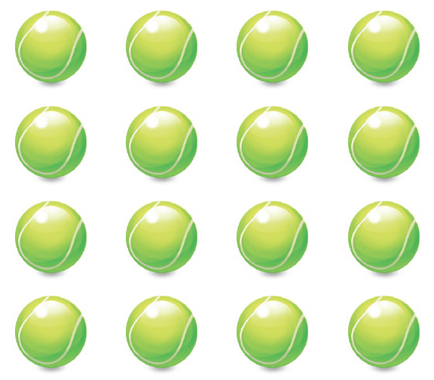
Learning the rhythm
Pass the ball

Slide 3
Ta
Sa
Ti-ti
This song has 3 “musical words”
When we see the symbol we say ….
And we play ….

Slide 4
Can you place the rhythm time names over the pictures of the balls?
What do the balls represent?
What does the stick Notation represent?

